Slide 1
CSE 2217: Data Structure and Algorithms
Introduction
Proof By Induction
Asymptotic notation

Slide 2
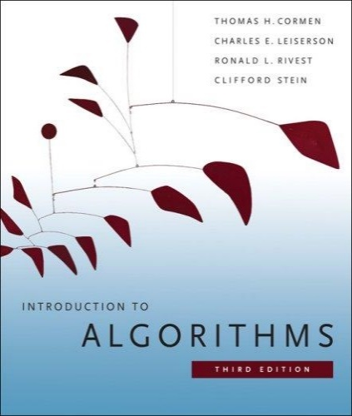
The Course
Purpose: a rigorous introduction to the design and analysis of algorithms
Not a lab or programming course
Not a math course, either
Textbook: Introduction to Algorithms::
Cormen, Leiserson, Rivest, Stein
An excellent reference you should own
Some additional materials may appear during lectures
** I appreciate feedback as we go along
** if something is a problem then tell me because it can often be fixed easily

Slide 3
The Course
Instructor: Dr. Mohammad Shahriar Rahman
Professor, CSE & Director, CITS
mshahriar@cse.uiu.ac.bd
Office: Director, CITS (5th floor)
This course:
This Classroom, On-campus
Materials shared on eLMS
For regular group communication???

Slide 4
Assessment Tools (Tentative)
Assessment Method | (%)
Attendance | 5
Assignments | 5
Class Tests (3/4) | 20
Midterm exam | 30
Final exam | 40

Slide 5
Algorithms
Algorithm
[merriam-webster.com] A procedure for solving a mathematical problem (as of finding the greatest common divisor) in a finite number of steps that frequently involves repetition of an operation; broadly :a step-by-step procedure for solving a problem or accomplishing some end especially by a computer
[Knuth, TAOCP] An algorithm is a finite, definite, effective procedure, with some input and some output.
Notes:
"Finite: there must be an end to it within a reasonable time.
Definite: precisely definable in clearly understood terms, no pinch of salt type vagaries, or possible ambiguities
Effective: the steps must be actually be able to be carried out. [simple enough for someone using pencil and paper to carry out in a finite amount of time]
Procedure: the sequence of specific steps arranged in a logical order.
Output: unless there is something coming out of the process, the result will remain unknown! "

Slide 6
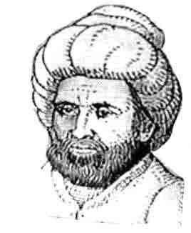
Etymology
Etymology. [Knuth, TAOCP]
Algorism = process of doing arithmetic using Arabic numerals.
A misperception: algiros [painful] + arithmos [number].
True origin: Abu 'Abd Allah Muhammad ibn Musa al-Khwarizm was a famous 9th century Persian textbook author who wrote Kitab al-jabr wa'l-muqabala, which evolved into today's high school algebra text.

Slide 7
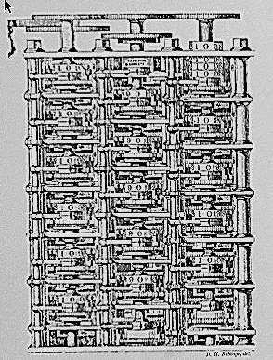
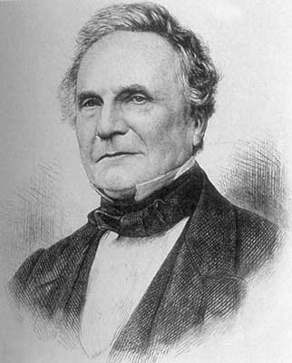
Theory of Algorithms
"As soon as an Analytic Engine exists, it will necessarily guide the future course of the science. Whenever any result is sought by its aid, the question will arise - By what course of calculation can these results be arrived at by the machine in the shortest time?” - Charles Babbage

Slide 8
Algorithmic Paradigms
Design and analysis of computer algorithms.
Greedy.
Divide-and-conquer.
Dynamic programming.
Network flow.
Intractability.
Coping with intractability.
Critical thinking and problem-solving.

Slide 9
Applications
Wide range of applications.
Databases.
Scheduling.
Networking.
Data analysis.
Signal processing.
Computer graphics.
Scientific computing.
Operations research.
Artificial intelligence.
Computational biology.
. . .
We focus on algorithms and techniques that are useful in practice.

Slide 10
What is Algorithm?
Algorithm
is any well-defined computational procedure that takes some value, or set of values, as input and produces some value, or set of values, as output.
is thus a sequence of computational steps that transform the input into the output.
is a tool for solving a well-specified computational problem.
Any special method of solving a certain kind of problem (Webster Dictionary)

Slide 11
What is an Algorithm?
An algorithm is a sequence of computational steps that solves a well-specified computational problem.
An algorithm is said to be correct if, for every input instance, it halts with the correct output
An incorrect algorithm might not halt at all on some input instances, or it might halt with other than the desired output.

Slide 12
What is a program?
A program is the expression of an algorithm in a programming language
a set of instructions which the computer will follow to solve a problem

Slide 13
Where We're Going
Examine methods of analyzing algorithm correctness and efficiency
Lower bound techniques
O,Omega and Theta notations for best/worst/average case analysis
Decide whether some problems have no solution in reasonable time
List all permutations of n objects (takes n! steps)
Travelling salesman problem (Given a list of cities and the distances between each pair of cities, what is the shortest possible route that visits each city exactly once and returns to the origin city?)
Investigate memory usage as a different measure of efficiency

Slide 14
The study of Algorithm
How to devise algorithms
How to express algorithms
How to validate algorithms
How to analyze algorithms
How to test a program

Slide 15
Importance of Analyzing Algorithm
Need to recognize limitations of various algorithms for solving a problem
Need to understand relationship between problem size and running time
When is a running program not good enough?
Need to learn how to analyze an algorithm's running time without coding it
Need to recognize bottlenecks in code as well as which parts of code are easiest to optimize

Slide 16
What do we analyze about them?
Correctness
Does the input/output relation match algorithm requirement?
Amount of work done (aka complexity)
Basic operations to do task
Amount of space used
Memory used

Slide 17
What do we analyze about them?
Simplicity, clarity
Verification and implementation.
Optimality
Is it impossible to do better?

Slide 18
Complexity
The complexity of an algorithm is simply the amount of work the algorithm performs to complete its task.

Slide 19
RAM model
has one processor
executes one instruction at a time
each instruction takes "unit time“
has fixed-size operands, and
has fixed size storage (RAM and disk).

Slide 20
The Selection Problem (1/2)
Problem: given a group of n numbers, determine the k^{th} largest
Algorithm 1
Store numbers in an array
Sort the array in descending order
Return the number in position k

Slide 21
The Selection Problem(2/2)
Algorithm 2
Store first k numbers in an array
Sort the array in descending order
For each remaining number, if the number is larger than the k^{th} number, insert the number in the correct position of the array
Return the number in position k
Which algorithm is better?

Slide 22
Which algorithm is better?
The algorithms are correct, but which is the best?
Measure the running time (number of operations needed).
Measure the amount of memory used.
Note that the running time of the algorithms increase as the size of the input increases.

Slide 23
Define Problem
Problem:
Description of Input-Output relationship
Algorithm:
A sequence of computational step that transform the input into the output.
Data Structure:
An organized method of storing and retrieving data.
Our task:
Given a problem, design a correct and good algorithm that solves it.

Slide 24
What do we need?
Correctness: Whether the algorithm computes
the correct solution for all instances
Efficiency: Resources needed by the algorithm
1. Time: Number of steps.
2. Space: amount of memory used.
Measurement “model”: Worst case, Average case
and Best case.

Slide 25
Methods of Proof
Proof by Contradiction
Assume a theorem is false; show that this assumption implies a property known to be true is false -- therefore original hypothesis must be true
Proof by Counterexample
Use a concrete example to show an inequality cannot hold
Mathematical Induction
Prove a trivial base case, assume true for k, then show hypothesis is true for k+1
Used to prove recursive algorithms

Slide 26
Proof by Contradiction
assume that the hypothesis and the negation of the conclusion are true; then deduce some contradiction from these assumptions.
Example: Prove that “If a number added to itself gives itself, then the number is 0.”
The hypothesis (P) is a + a = a and the conclusion (Q) is a = 0. Hence, the hypotheses for the proof by contradiction are:
a + a = a and a ≠0 (the negation of the conclusion)
Then 2a = a and a ≠0, hence dividing both sides by a, the result is 2 = 1, which is a contradiction. Hence, (a + a = a) → (a = 0).

Slide 27
Proof by Counterexample
Example: Prove that “For every positive integer n, n! ≤ n².”
Start testing some cases say, n = 1, 2, 3 etc.
It might seem like it is true for some cases but how far do you test, say n = 4.
We get n! = 24 and n² = 16 which is a counter example for this theorem. Hence, even finding a single case that doesn’t satisfy the condition is enough to disprove the theorem.

Slide 28
Proof By Induction
Claim: S(n) is true for all n >= k
Basis:
Show formula is true when n = k
Inductive hypothesis:
Assume formula is true for an arbitrary n
Step:
Show that formula is then true for n+1

Slide 29
Induction Example: Gaussian Closed Form
Prove 1 + 2 + 3 + … + n = n(n+1) / 2
Basis:
If n = 0, then 0 = 0(0+1) / 2
Inductive hypothesis:
Assume 1 + 2 + 3 + … + n = n(n+1) / 2
Step (show true for n+1):
1 + 2 + … + n + n+1 = (1 + 2 + …+ n) + (n+1)
= n(n+1)/2 + n+1 = [n(n+1) + 2(n+1)]/2
= (n+1)(n+2)/2 = (n+1)(n+1 + 1) / 2

Slide 30
Induction Example: Geometric Closed Form
Prove a⁰ + a¹ + … + a^{n} = (a^{n+1} - 1)/(a - 1) for all a ≠ 1

